Slide 1
Ms dos Commands
Written by Layth.A

Slide 2
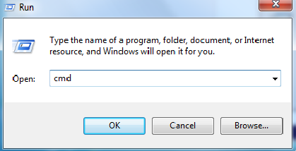
How to Open MS-DOS Command Prompt open run window then type cmd
Written by Layth.A

Slide 3
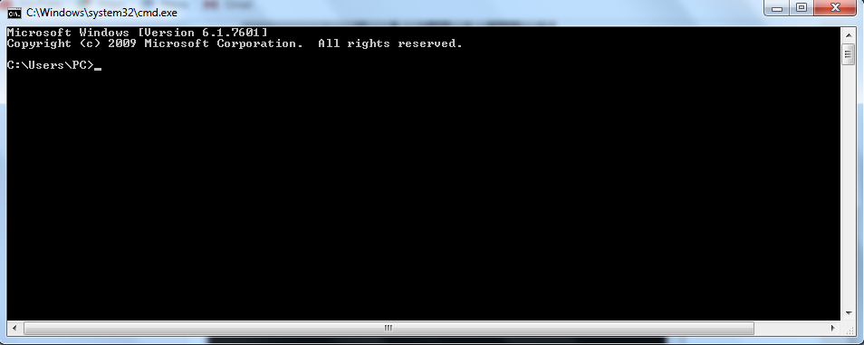
Ms dos prompt
Written by Layth.A

Slide 4
MS-DOS Commands :: md (mkdir)
Creates a directory.
The command mkdir is the same as the md command, they do the same thing.
Written by Layth.A

Slide 5
2-MS-DOS Commands :: cd (change directory)
Use the cd command to make a different directory the "current" directory ("cd" is short for "change directory").
Written by Layth.A

Slide 6
DOS Instructions:
CD Instruction: used for moving between folders ,for example
1)to move from used folder to one back folder.
cd ..
2)to move directly to C part.
cd\
Cd filename
filename is the name of the folder wonted to move to or the completed path of it .
Written by Layth.A

Slide 7
3-MS-DOS Commandes :: NOTEPAD to create file
PC\A > notepad list.txt
Type list.txt
Written by Layth.A

Slide 8
3-MS-DOS Commands :: Tree
A:\
B
C
c1
c2
b1
Note//All is Folders and sub folders
Written by Layth.A

Slide 9
C:\>md A
C:\>cd A
C:\ A>
C:\A>md B
C:\A>md C
C:\A>cd B
C:\ A\ B> md b1
C:\ A\ B> cd ..
C:\ A>cd C
C:\ A\C>md c1
C:\ A\C>md c2
C:\ A\C>cd ..
C:\ A>tree

Slide 10
Deleting folders
To delete a directory, use the rd command. The rd command stands for "remove directory
A:\>
B
C
c1
c2
b1

Slide 11
Deleting files To delete a file, you will use the del command.

Slide 12
Create the following tree by using MS dos
GF:\>
S2
S1
D1
Page1.txt
page

Slide 13
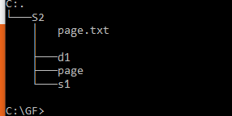
Results quiz

Slide 14
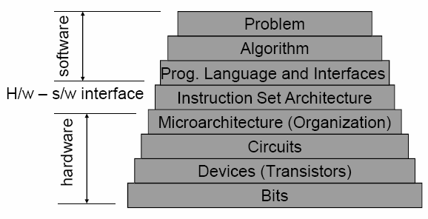
Machine language

Slide 15
Binary number system is made of only 0 and 1 bit is a single binary digit
₂⁶
₂⁵
₂⁴
₂³
₂²
₂¹
₂⁰
0
0
0
0
0
0
0
Example
0+0=0
0+1=1
1+1=10
(1101)₂=(13)₁₀

Slide 16
Binary vs Decimal (13)₁₀ ₌ (1101)₂ (13)₁₀ ₌ (13/2=6 and remained = 1 6/2=3 and remained = 0 3/2=1 and remained = 1 1/2=0 and remained = 1 _{up down left right}

Slide 17
( 1.1)_{2 =?} (10.101)_{2=?} ₍₂₅₎₁₀

Slide 18
transistors in cpu configuration -Or gate -AND gate -not Gate F=A+AB (A and B is inputs) f=a(BC)=AB+AC outputs =2^{n (N= number of input )}

Slide 19
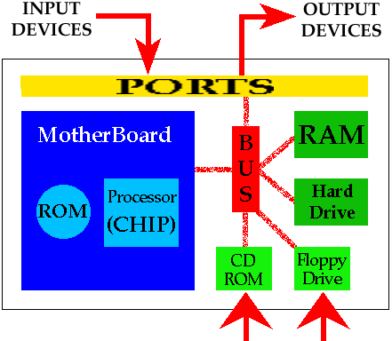
computer components

Slide 20
What happened WHENPRESSING THE POWER BUTTEN
POST/ IS PERFORMED TO CHECK ALL HRADWARE IN SIDE COMPUTER
BIOS /CHECH THE HARD DRIVE FOR BOOT LOADER LOACATED IN THE FIRST SECTOR OF hd
BOOT LOADER/ LOOKS FOR OS AND LOAD IT LIKE WINDOWS OR MAC OX LINUX .
STARTS UP PROGRAMS .EX ANITVIRUS
WIN REGISTRY IS A DATABASE INFORMATION AND SETTing ,VALUES FOR SOFTWARE IN OS WHEN NEW PROGRAM NEW SUBKEY CREATE AND IT WILL ADD IN WIN REGISTRY

